Slide 1


Green Pace
Security Policy Presentation
Developer: Joseph A. Urso

Slide 2

OVERVIEW: DEFENSE IN DEPTH

Slide 3
THREATS MATRIX
Likely STD-STR51-CPP STD-FIO30-C STD-MEM50-CPP STD-ERR51-CPP STD-CTR53-CPP | Priority P18 P18 P18 P4 P6
Low priority P4 P3 P1 P4 | Unlikely STD-INT50-CPP STD-DCL52-CPP STD-DCL03-C STD-EXP57-CPP

Slide 4
10 PRINCIPLES
Validate Input Data – Data Type (STD-INTO50-CPP)
Heed Compiler Warnings
Architect & Design for Security Policies – String Correctness (STD-STR51-CPP), Containers (STD-CTR53-CPP), File Management (STD-FIO42-C)
Keep It Simple
Default Deny – SQL Injection (STD-FIO30-C)
Adhere to the Principle of Least Privilege
Sanitize Data Sent to Other Systems
Practice Defense in Depth
Use Effective Quality Assurance Techniques – Data Value (STD-DCL52-CPP), Assertions (STD-DCL03-C), Exceptions (STD-ERR51-CPP)
Adopt a Secure Coding Standard – Memory Protection (STD-MEM50-CPP), Class Pointers (STD-EXP57-CPP)

Slide 5
CODING STANDARDS
String Correctness – P18
SQL Injection – P18
Memory Protection – P18
Containers – P6
Data Type – P4
Exceptions – P4
Class Pointers – P4
File Management – P4
Data Value – P3
Assertions – P1

Slide 6
ENCRYPTION POLICIES
In Rest – Encrypting data that is stored on a disk or other drive. If an attacker obtains access to an encrypted drive and doesn’t have the keys, they can’t access it.
At Flight – This is the process of encrypting data while being transmitted, this would apply to all data between servers and devices that could be compromised.
In Use - This is securing data by ensuring it’s never left ‘unsecure.’ This would include using permission-based roles in order to mitigate attacks on data in use.

Slide 7
TRIPLE-A POLICIES
Authentication – Authenticating users via usernames, passwords and other mechanisms applies when utilizing standards of default deny and permission-based coding.
Authorization – This follows authentication and is a second layer of authorizing a user for a particular set of tasks and access to relevant data. This also applies to useful coding standard practice.
Accounting - Accounting is a method of monitoring resources used during access to the network. This includes data, time, and connections during a particular session. It’s important for analysis and keeping a secure log of all activities by user.

Slide 8
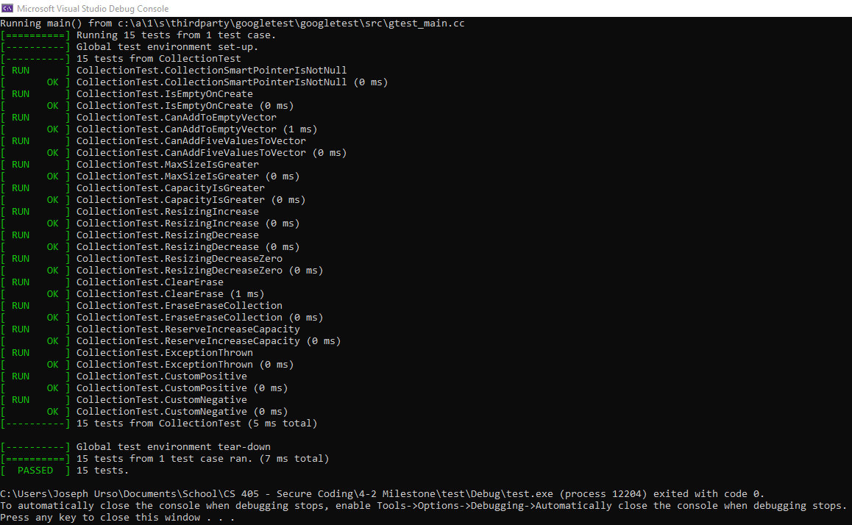
Exceptions Unit Testing
Following the use of unit testing on exceptions, below a console screenshot shows the successful results of running exceptions on intentional negative and positive code:

Slide 9

AUTOMATION SUMMARY

Slide 10
TOOLS
The DevSecOps pipeline is a development pipeline similar to DevOps that adds in additional layers of security measures and practices alongside the typical development pipeline to effectively mitigate vulnerabilities and flaws in code.
The automation tools best used for enforcing the coding standards and the new DevSecOps pipeline will be considered during the pre-production phase. Planning will include the consideration of such automated tools, and they will be utilized while building and verifying the integrity of the system. Following, they will remain as steadfast static and runtime testing tools during production timelines of monitoring, detecting and responding to any flaws in the system.

Slide 11
RISKS AND BENEFITS
The strategies should be implemented now while development is being planned in order to best replicate the DevSecOps pipeline and properly integrate best security practices within functional code. The benefits ultimately lead to less time on remediation, lower costs on maintenance, and a better end-user experience.
If one was to wait on implementing said strategies, the results would be higher costs of post-implementation, as well as running the risk of not identifying vulnerabilities before they are exposed by an attacker.

Slide 12
RECOMMENDATIONS
Gaps in the security policy include: standards not discussed in the presentation, rules and practices that don’t currently apply to the product, and scalability of the policy going forward.
The policy will likely need to be expanded upon as the product continues to grow, develop and utilize new technologies over time.
For this, all standards and more rules should be referenced and included in the DevSecOps pipeline as they become relevant to pieces of functionality that exist within the program.

Slide 13
CONCLUSIONS
Practical coding standards should be adopted going forward to prevent problems in the future due to the scalable nature of software development.
Some of these standards surround those of proper memory, file, and exception management, among others.
The coding standard reference sheet should be reviewed and updated accordingly with new pieces of functionality.
It would be best to ensure that security plays an important role in any agile-scrum environments and meetings alongside development tasks for the week / month.

Slide 14
REFERENCES
Rules.sonarsource.com. n.d. C++ static code analysis. [online] Available at: <https://rules.sonarsource.com/cpp> [Accessed 16 October 2021].
Shrum, S. and Schiela, R., 2017. 1 Front Matter - SEI CERT C++ Coding Standard - Confluence. [online] Wiki.sei.cmu.edu. Available at: <https://wiki.sei.cmu.edu/confluence/display/cplusplus/1+Front+Matter> [Accessed 16 October 2021].

